Slide 1


Wi-Fi Technology
Group 6
Nguyen Tran Phong
Vo Van Thanh Phuc
Pham Tien Phat

Slide 2
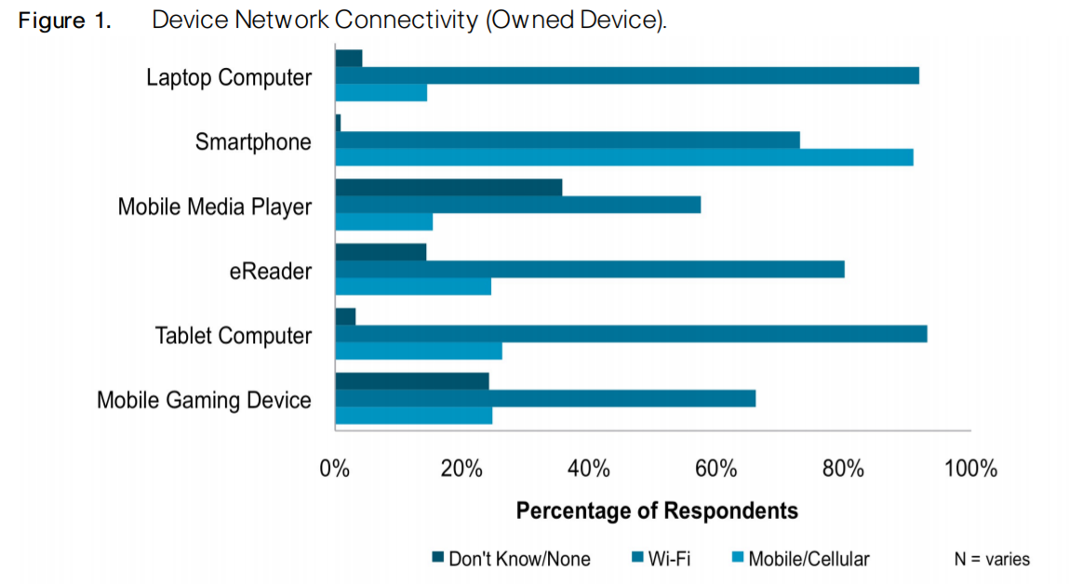
What people use to connect their device to the Internet, by mobile cellular or by Wi-Fi?
Source: Taylor et al, Cisco - What do customers want from Wifi, 2012

Slide 3
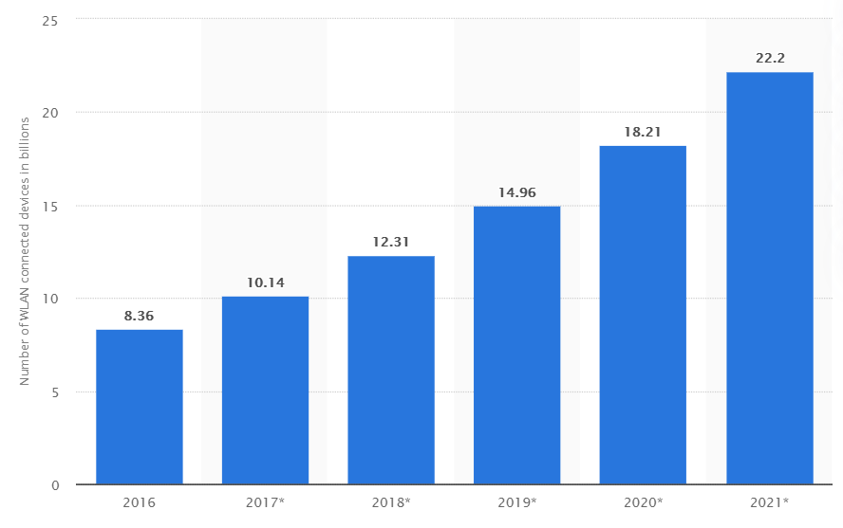
Number of Wireless Local Area Network (WLAN) connected devices worldwide from 2016 to 2021 (in billions)
Source: S. O’Dea, Statista, 2020

Slide 4



WI-FI technology
What is Wi-Fi?
How does Wi-Fi work?
History of Wi-Fi development
802.11 Architecture
Benefits and Disadvantages of Wi-Fi
Future of Wi-Fi
Security Protocols of Wi-Fi

Slide 5



What is wi-fi ?
Wi-Fi
Radio waves
High-speed
network and
Internet connections

Slide 6
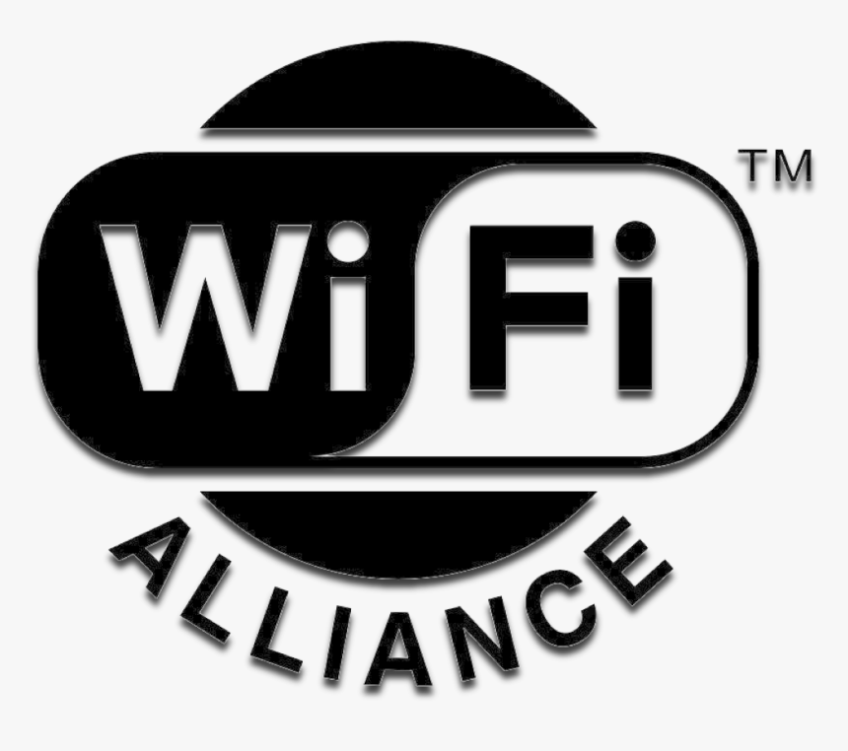

Open.
Non-profit.
Responsible of Wi-Fi standards development, marketing, Wi-Fi certification,…

Slide 7


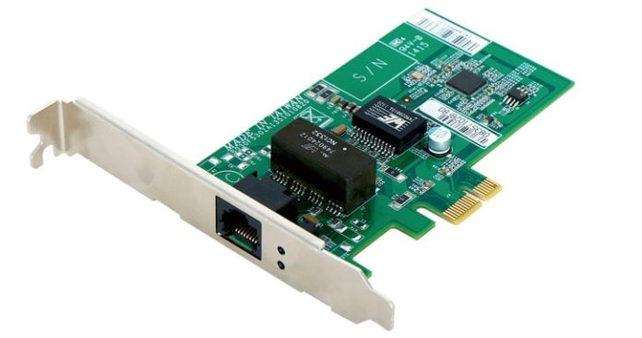


How does wi-fi work?
DATA
DATA

Slide 8
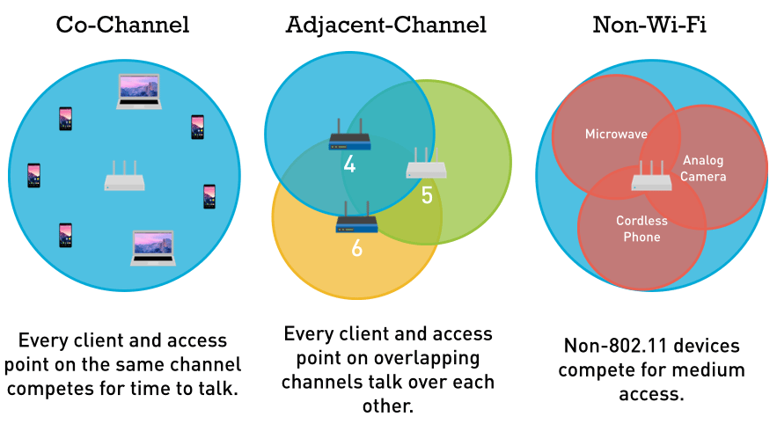
Wi-fi channel
2 GHz
or
5Ghz

Slide 9
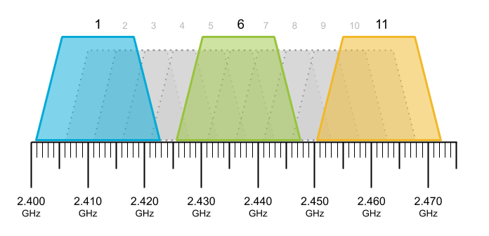
Wi-fi channel

Slide 10

HISTORY OF WI-FI

Slide 11

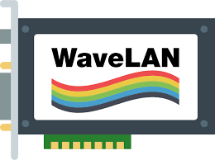
Network standard
Release of wavelan
1971
1985
1990
1973
1988
The presentation
Open network use
Father of Wi-Fi

Slide 12
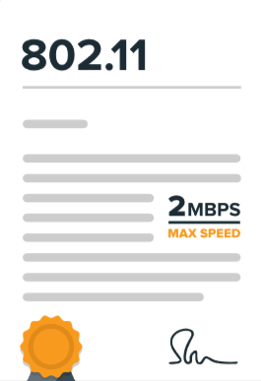
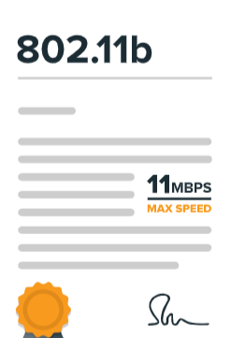
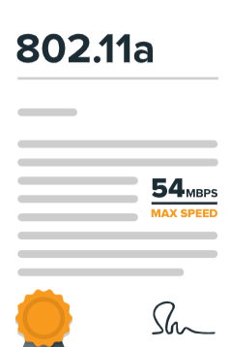
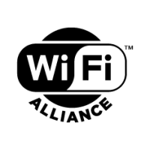

802.11 Protocol
802.11b Protocol
1993
1999
2000
1997
1999
Public hotspot
Wi-Fi Alliance
802.11a Protocol

Slide 13
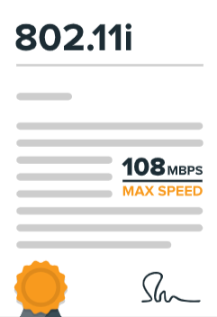
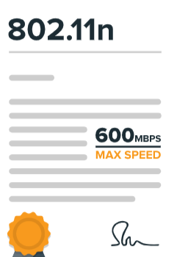
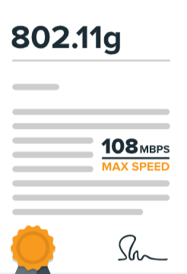
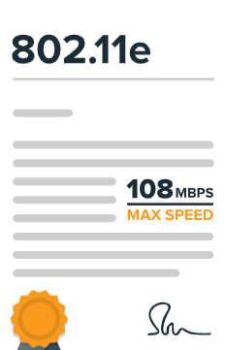
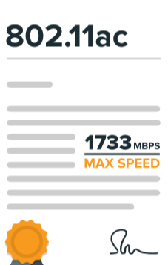
802.11i Protocol
802.11n Protocol
2003
2005
2014
2004
2009
802.11g Protocol
802.11e Protocol
802.11ac Protocol

Slide 14
802.11 Architecture

Slide 15
Application
HTTP, FTP, SMTP etc.
DHCP, RTP, TFTP, etc.
Host
TCP
UDP
IP
802.2 Logical Link Control (LLC)
802.11 Media Access Control (MAC)
Radio
Physical Layer (PHY)
(802.11b DSSS, 802.11g OFDM, 802.11n MIMO etc.)

Slide 16
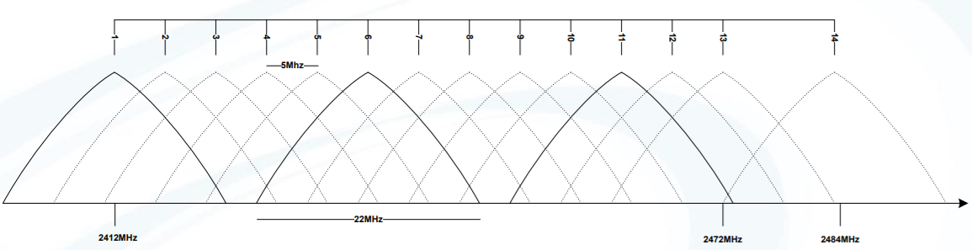
Physical Layer
2.4 GHz and/or 5GHz transceiver
Spread spectrum technology
FHSS (Frequency Hopping Spread Spectrum)
DSSS (Direct Sequency Spread Spectrum)
OFDM (Orthogonal Frequecy-Division Multiplexing)
Europe: channels 1-13
USA: channels 1-11
Japan: channels 1-14

Slide 17
Physical Layer
Standard
Frequency
Bandwidth
Symbol rate (Mb/s)
802.11
802.11a
802.11b
802.11g
802.11n
2.4GHz
5GHz
2.4GHz
2.4GHz
2.4/5GHz
20
20
20
20
40
20
1,2
6, 9, 12, 18, 24, 36, 48, 54
5.5,11
6, 9, 12, 18, 24, 36, 48, 54
7.2, 14.4, 21.7, 28.9, 43.3, 57.8, 65, 72.2

Slide 18
Media Access Control (MAC)
Function | Explanation
Scanning | Scanning of access points. Both active (probe) and passive (beacon) scanning are provided by the standard.
Authentication | Authentication is the process of proving identity between the client and the access point.
Association | Once authenticated, the client must associate with the access point before sending data frames.
Encryption | Encryption of payload.
RTS/CTS | The optional request-to send and clear-to-send (RTS/CTS) function allows the access point to control use of the medium for stations activating RTS/CTS.
Power Save Mode | The power save mode enables the user to turn on or off enables the radio.
Fragmentation | The fragmentation function enables an 802.11 station to divide data packets into smaller frames.

Slide 19
Logical Link Control (LLC)
The LLC provides end-to-end link control over 802.11-based wireless LA
LLC services
Unacknowledged connectionless service
Connection-oriented service
Connectionless service

Slide 20

Application
HTTP, FTP, SMTP etc.
DHCP, RTP, TFTP, etc.
TCP
UDP
IP

Slide 21


SECURITY PROTOCOLs OF WI-FI
What is Wireless security?
Unauthorized access / damage
Wireless security

Slide 22
SECURITY PROTOCOLs OF WI-FI
Wi-Fi Security Protocols
WEP (Wired Equivalent Privacy)
WPA (Wi-fi Protected Access)
WPA2
WPA3

Slide 23








SECURITY PROTOCOLs OF WI-FI
Protocol | Time | Evaluation |  | Further more
 |  | Security | Configurable
Easy to break.
Hard to configure.
Abandoned.
1999 – 2004 standard
WEP
One year before WEP was officially abandoned
Was used as a temporary enhancement for WEP.
Easy to break.
Configuration: moderate.
WPA
WPA2
Since 2004
AES encryption.
WPA3
Coming soon
Password protection.
Wi-Fi easy connect.

Slide 24




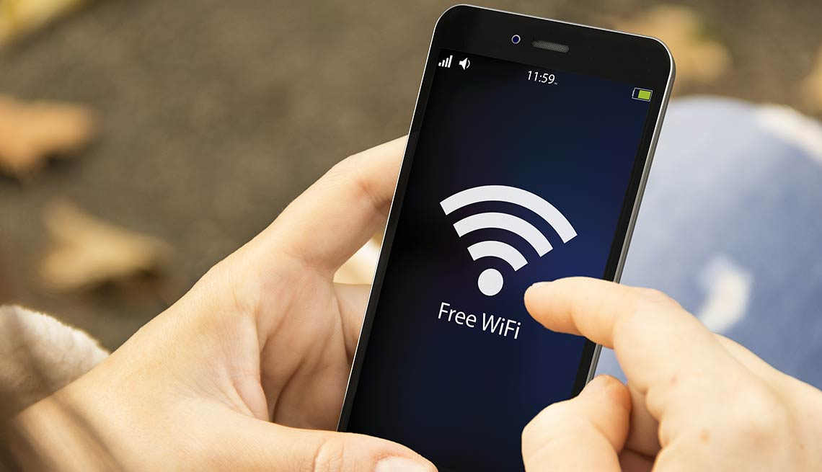
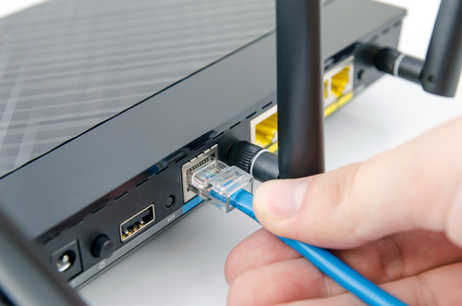
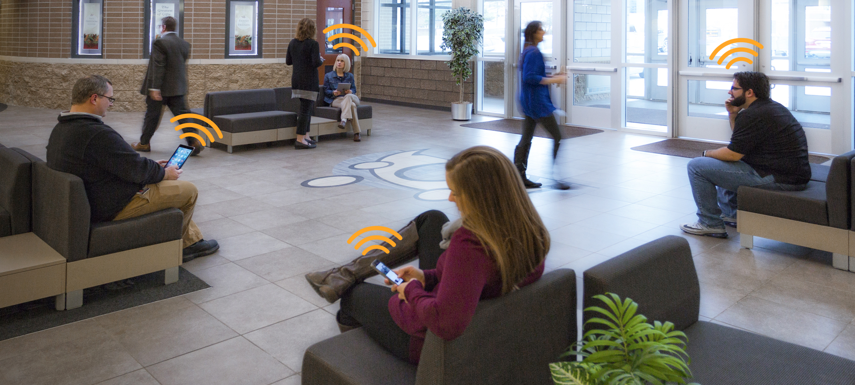
Benefits of wifi
Convenience
Productivity
Easy and fast installation
Mobility
Expandability
Low cost

Slide 25
Benefits of wifi
Preferred Network Access
Attribute | Mobile / Cellular | WiFi | No Difference
Lowest Cost | 20% | 56% | 24%
Speed of Network | 18% | 58% | 24%
Best Reliability | 31% | 46% | 23%
Best Performance for My Applications | 27% | 46% | 27%
Best Coverage | 46% | 35% | 19%
Most Secure | 34% | 35% | 31%
Easier to Use | 29% | 40% | 31%
Source: Taylor et al, Cisco - What do customers want from Wifi, 2012

Slide 26
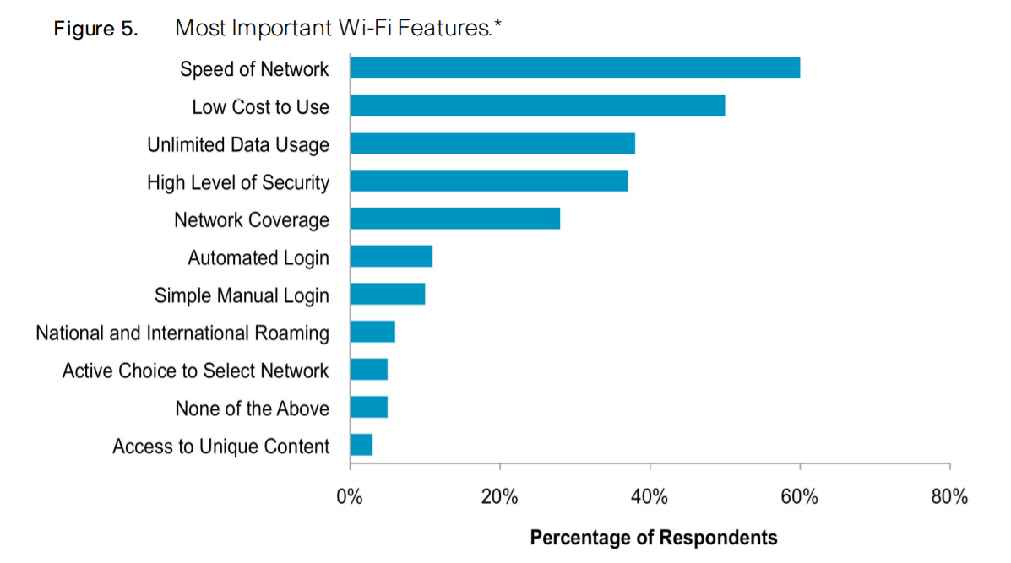
Benefits of wifi
Source: Taylor et al, Cisco - What do customers want from Wifi, 2012

Slide 27
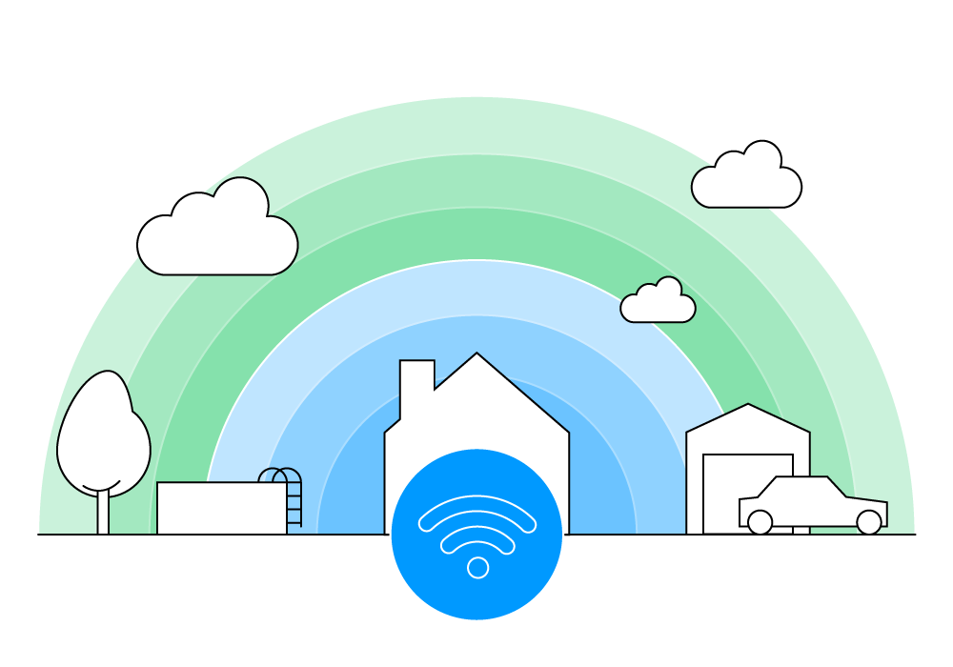
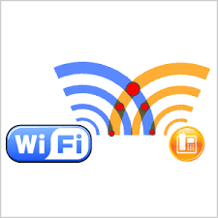


DISADVANTAGES of wifi
Security
Range
Reliability
Speed

Slide 28
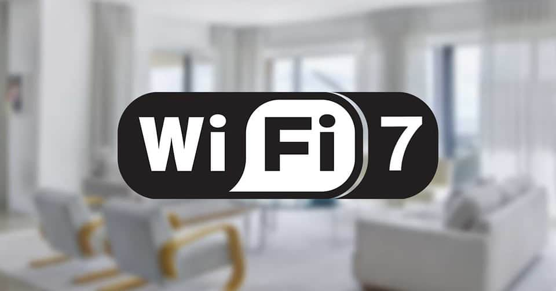
Future of wi-fi
Wi-fi 7 (802.11be)
6 GHz band ➔ Offering high-speed Wi-Fi.
Support multi-band and multi-channel.
Handle a numerous of devices simultaneously.

Slide 29
References
Wikipedia tiếng Việt: https://vi.wikipedia.org/wiki/Wi-Fi
Wikipedia tiếng Anh: https://en.wikipedia.org/wiki/Wi-Fi
Digital trends – What is Wifi?: https://www.digitaltrends.com/computing/what-is-wi-fi/
Elprocus – How does Wifi work?: https://www.elprocus.com/how-does-wifi-work/
AVM – Everything about Wifi : https://en.avm.de/guide/everything-about-wifi/
Cisco – What do customers want from Wifi: https://www.cisco.com/c/dam/en_us/about/ac79/docs/sp/SP_Wi-Fi_Consumers.pdf
bluegiga - PDF - Present - Wifi Technology: https://drive.google.com/file/d/1YWq3X3a_BK320YY94MiLlZHSV60ezFUf/view?usp=sharing
NetSpot - Wireless Security Protocols: WEP, WPA, WPA2, and WPA3: https://www.netspotapp.com/wifi-encryption-and-security.html#:~:text=WiFi%20routers%20support%20a%20variety,needs%20to%20protect%20your%20network.
iPoint-Tech - Wireless Networking (Wi-Fi) – Advantages and Disadvantages to wireless networking - https://ipoint-tech.com/wireless-networking-wi-fi-advantages-and-disadvantages-to-wireless-networking/

Slide 30

THANK YOU FOR YOUR ATTENTION

